Slide 1
ROBOT CLEANER
Zehra Füreyya Erdoğan / 122207074
Hasan Yücel
Selin Rabia Kinsiz / 12207037

Slide 2
PROJECT’S PURPOSE
The project’s goal is to create a robot that cleans an area while avoiding hitting objects around it. The robot has an ultrasonic sensor in the front that makes it collision-free. Thanks to mop attachment at its bottom, it avoids collisions and cleans the area at the same time.

Slide 3
Our project is a prototype of Automatic Vacuum Cleaners . It has one ultrasonic sensor on the front which makes the robot collision- free. Prior to project development, considerations were given to factors such as cost-effectiveness, design simplicity and, low-profile construction. Our aim was to achieve something that is a luxury in a simple way.
If these devices were lower priced, like we aimed to do, they wouldn’t only be in the home environments more, but they would also become a part of the streets. Since the population is too high, manpower in the service industry becomes insufficient every day. To solve this endless problem completely, imagine that there are Robot Cleaners on the streets all the time without getting tired, hungry, or sleepy. While it reduces the expenses in long term, it is also more efficient than a human worker. With this power, not only our streets, but also our world would become cleaner.

Slide 4
Hence, the Robot Cleaner is simple yet useful solution that benefits environmental considerations. By addressing significant problems, such as environmental pollution, with the simplest solutions, we not only save our recourses but also prepare a more sustainable future for the next generations.

Slide 5
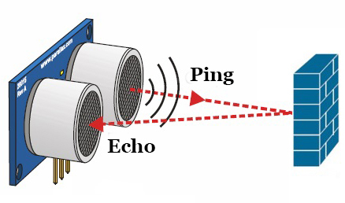
Experiment Set-Up
a) HC-SR04 Ultrasonic Sensor
An ultrasonic sensor measures the distance by using ultrasonic sound waves which are at a frequency above the range of human hearing. The sensor determines the distance to a target by measuring time lapses between the sending and receiving of the ultrasonic pulse.
For presence detection, ultrasonic sensors detect objects regardless of color, surface, or material. However, they are insensitive to light, dust, smoke and vapor.

Slide 6
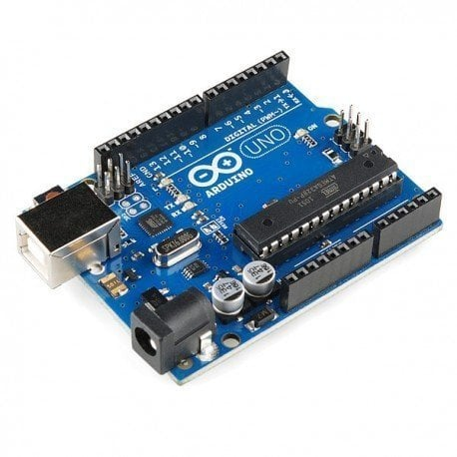
Experiment Set-Up
b) Arduino Uno R3
Arduino UNO is a microcontroller board based which has 14 digital input/output pins, 6 analog inputs, a 16 MHz ceramic resonator, a USB connection, a power jack, an ICSP header and a reset button.

Slide 7
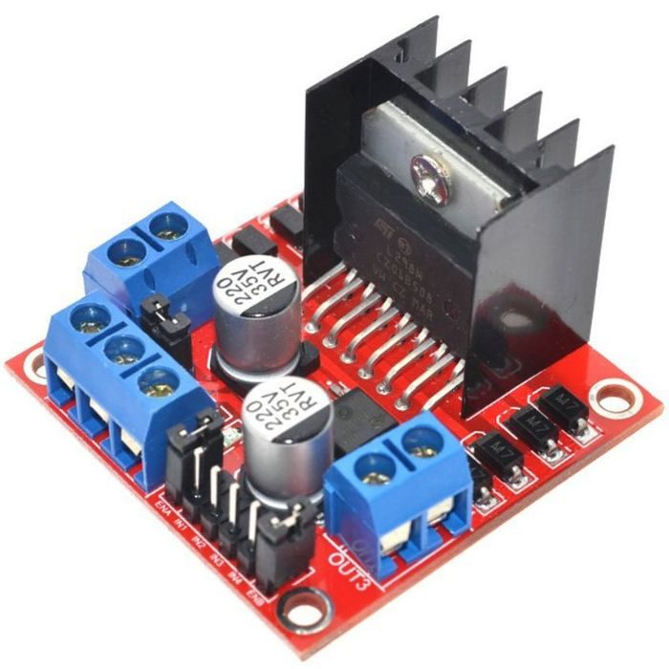
Experiment Set-Up
c) L298N Dual Motor Driver Board
Motor Driver Board controls motor speed and rotation direction of two DC motors. The L298N module can be used with motors that have a voltage between 5 and 35V DC.

Slide 8
Building The Robot
1− Firstly, we fixed the 2 DC motors to the chassis with screws.
2− Then, we attached the wheels to the motors and fixed the ball caster at the front side of the chassis.
3− After that we attached the motor driver board on the chassis.
4− We fixed the battery slot to the chassis.
5− After that, we fixed the Arduino Uno R3 next to the battery slot.
6− After making the necessary attachments with the jumper cables we fixed the ultrasonic sensor to the front side of the chassis.
7− Then, we made the connections as follows (Figure 6):
8− Finally, we made the final programme on Arduino an run the robot.

Slide 9
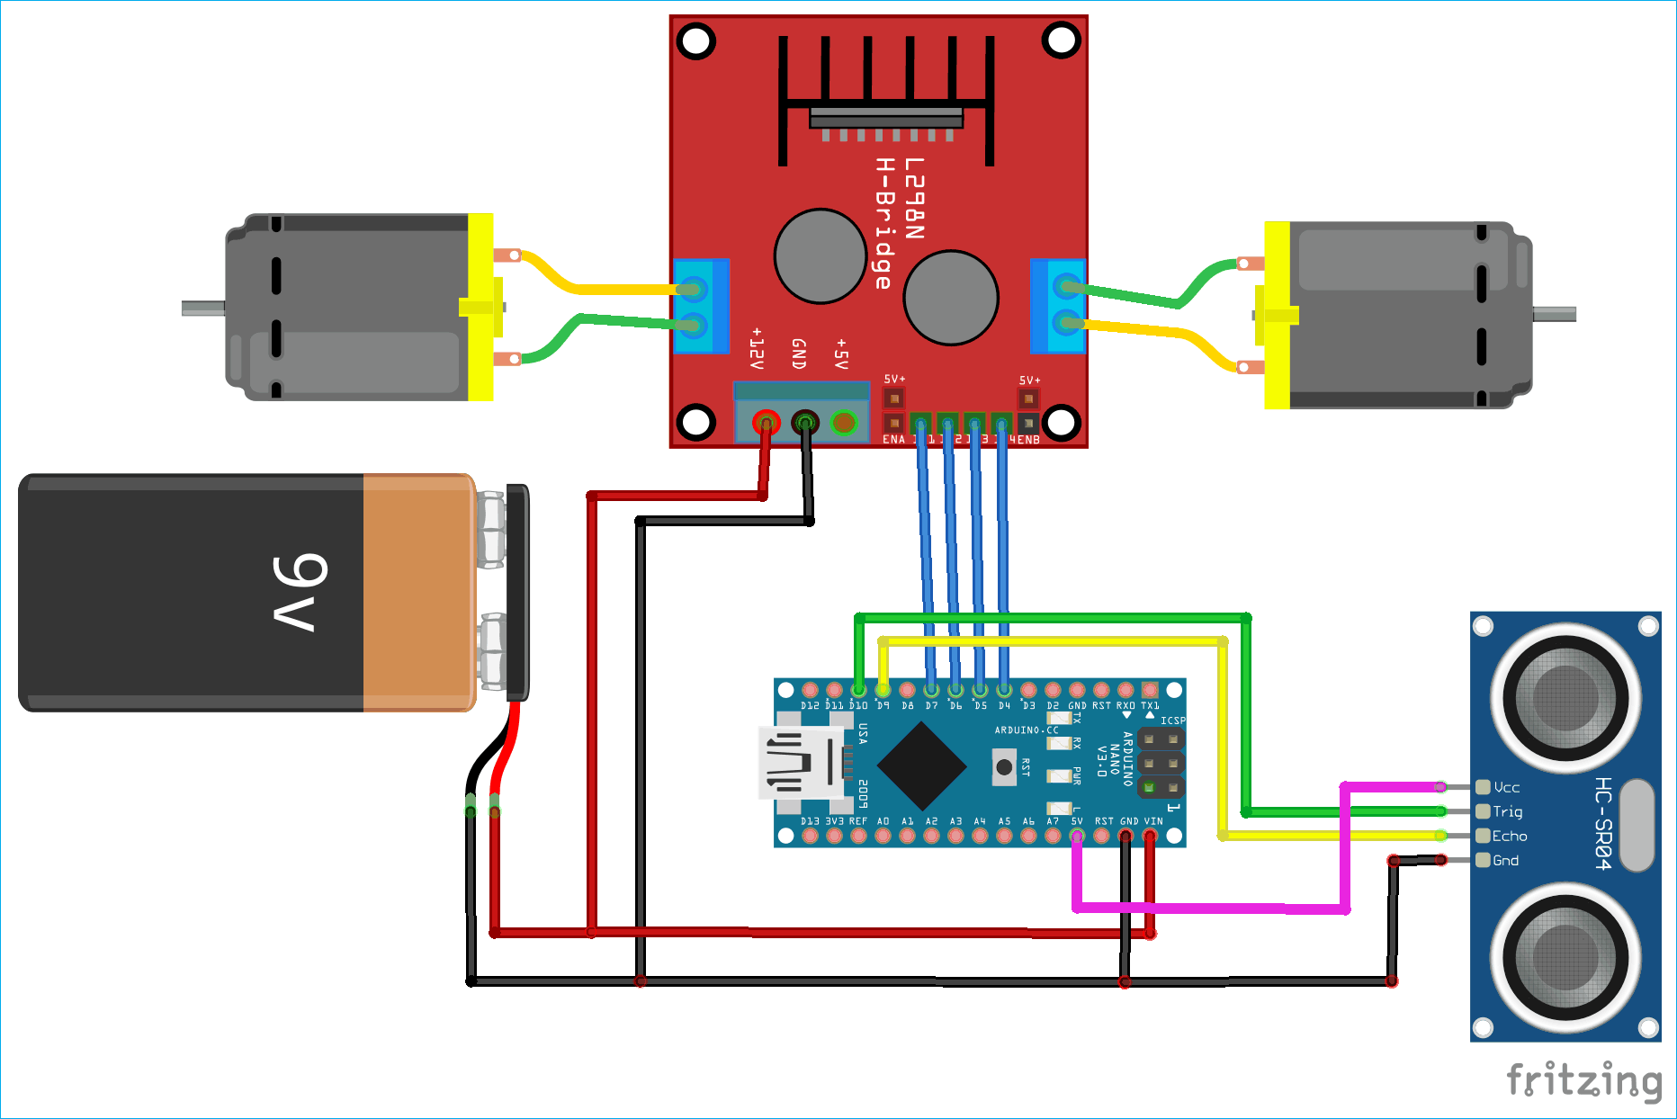
Building The Robot

Slide 10
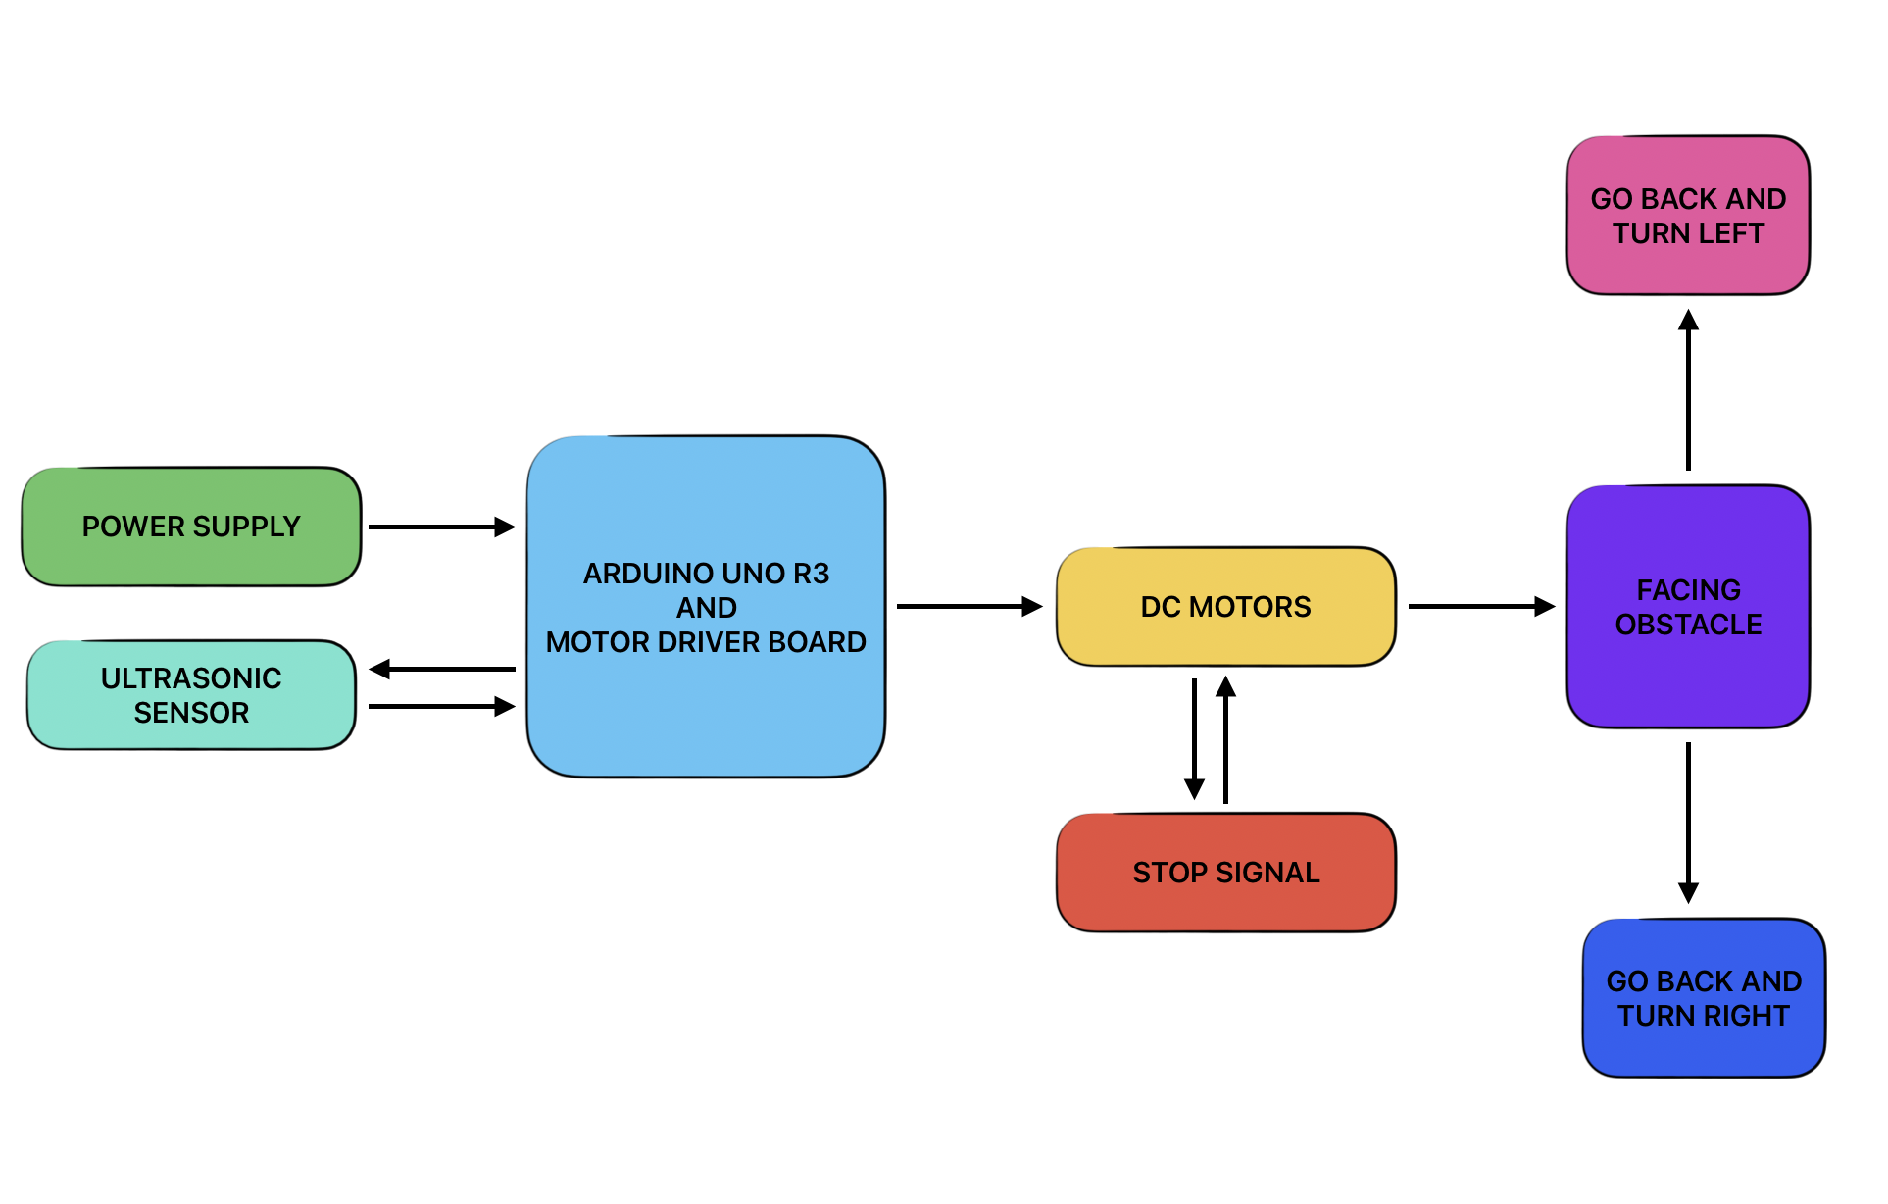
Building The Robot
As shown in the Figure, the ultrasonic sensor sends the data which it calculated as told in methodology, sends it to Arduino Uno R3 and Arduino manages it then sends a default data to motor driver board. After that, the motor driver board converts our input to a physical action and starts moving. To illustrate, while the robot moves it calculates its movements at every step. If it doesn’t come across to any object, it doesn’t change its direction. However, if the sensor detects any object near; robot changes its direction as shown in Figure .

Slide 11
APPENDIX
…

Slide 12
APPENDIX
…

Slide 13
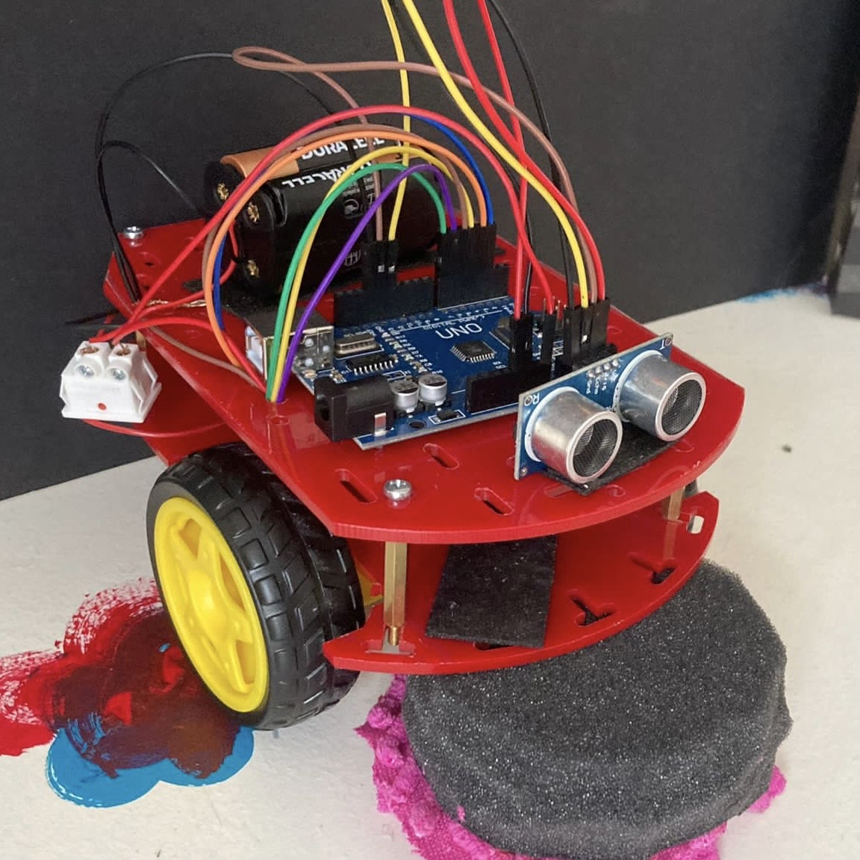
CONCLUSION
This prototype could be improved with Bluetooth module to use our mobile phones as a remote control, better cleaning parts like adding vacuum to the system, adding more sensors for better movements, and updating code to catch up with these evaluated movements.

Slide 14
What makes this robot different than the actual ones is that it is more reachable because of its lack of features as mentioned. Since it is more reachable, that means that more people can use it. We can have them in streets, cleaning the endless roads and making our environment lot cleaner. The current product has insufficient battery space since the ones we have used has lower voltage than Lithium-Polymer batteries. Using that kind of batteries would lead the robot to have longer run time and have less ecological footprint.
The final product is parallel to the objectives that were set in the beginning. The robot cleaner cleans while it moves around, and the cost of this device couldn’t be compared to the actual robot cleaners. It does have less features however our robot cleaner works and its simplicity doesn’t lower its capacity. The outcome is what we were aiming to do in the first place.

